Slide 1

The Future of Vertical Flight
Dan Gettinger, Director of Publications and Communications
The Vertical Flight Society
www.vtol.org • dgettinger@vtol.org

Slide 2
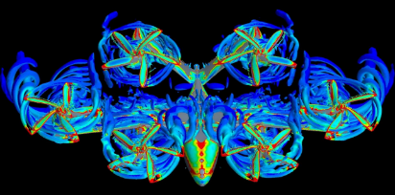
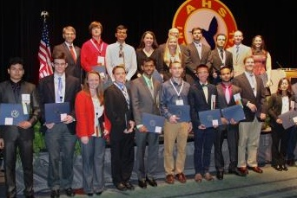
What is The Vertical Flight Society?
The international professional society of
6,500 members working to advance vertical flight
  Founded in Feb 1943 as the American Helicopter Society (AHS)
  Everything from VTOL MAVs/UAS to helicopters, eVTOL, etc.
Expands knowledge about vertical flight technology and promotes its application around the world
Advances safety and acceptability
Advocates for vertical flight R&D funding
Helps educate and support today’s and tomorrow’s vertical flight engineers and leaders
Brings together the community — industry, academia and government agencies — to tackle the toughest challenges
CFD of Joby S4, Aug 2015
Join us today: www.vtol.org
VFF Scholarship Winners at Forum 71, May 2015

Slide 3
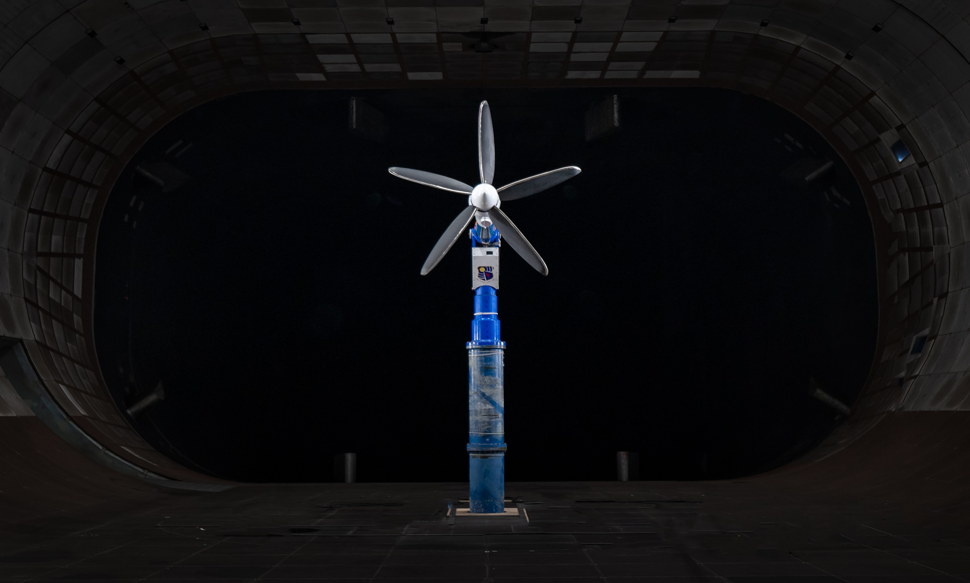
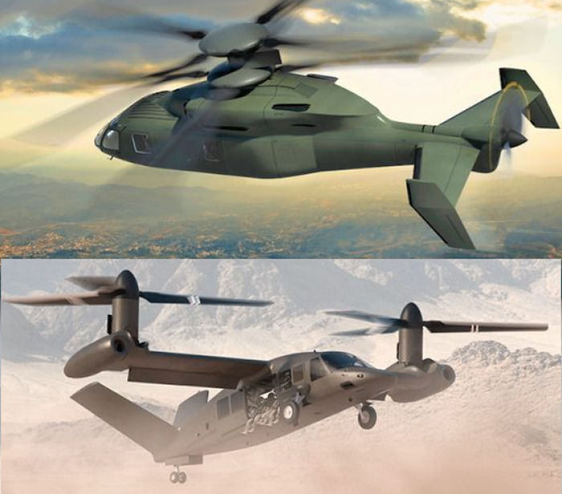
An 80-Year Legacy
VFS has a long history of advocacy and leadership
  Helped establish NASA-Army Joint Office, Nat’l Rotorcraft Technology Center (NRTC), Centers of Excellence, RITA/VLC
  Worked with NASA and DoD to save the NFAC wind tunnel
Provided major support to transformative initiatives
  Joint Strike Fighter/F-35B STOVL Lightning II
  V-22 Osprey tiltrotor
Now providing major foundational support to new transformative initiatives
  Joint Multi-Role (JMR) / Future Vertical Lift (FVL)
  Electric, hybrid and hydrogen-electric VTOL (eVTOL)
Joby at NFAC 40 ft x 80 ft wind tunnel
Courtesy of Joby
VFS Works to Advance Vertical Flight!
Future Vertical Lift (FVL)
Sikorsky-Boeing Defiant and Bell Valor

Slide 4

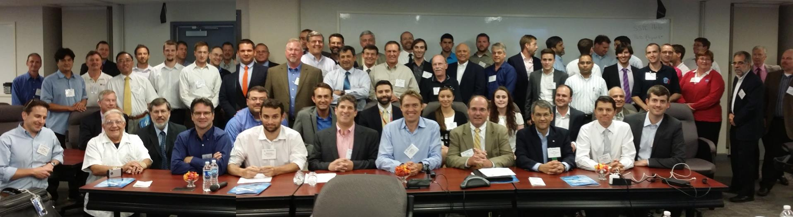
VTOL Innovators – Then and Now
1st AHS Banquet
1944
1st eVTOL Workshop
2014

Slide 5
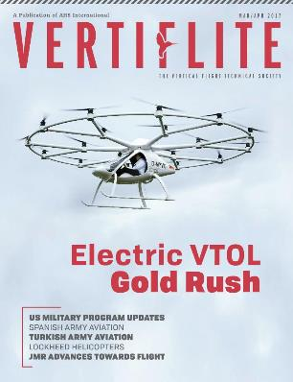
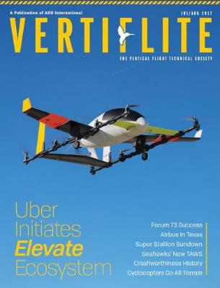
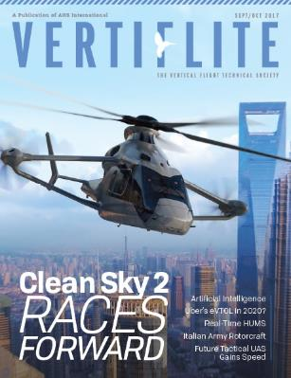
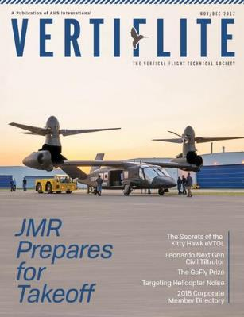
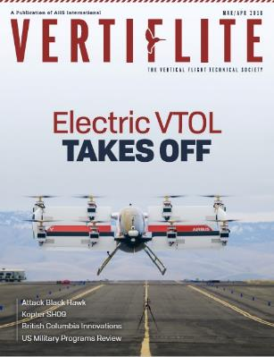
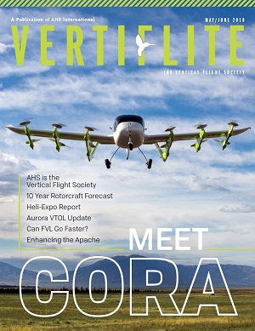
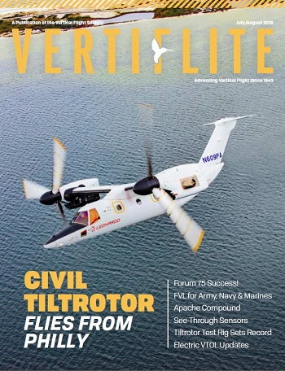
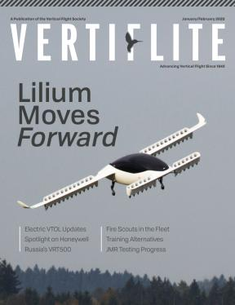
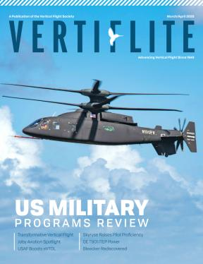
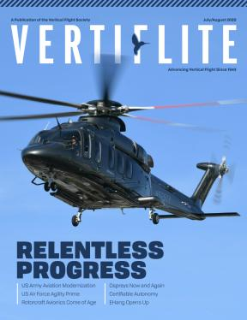
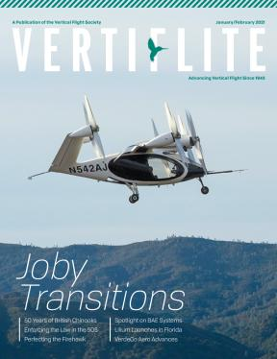

Vertiflite Covers Advanced VTOL

Slide 6
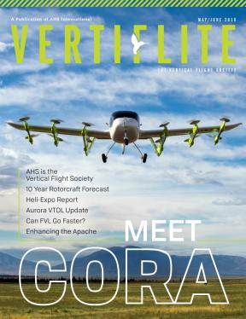

VFS Technical Resources
Annual Forum & Conferences: www.vtol.org/events
  Technical meetings from 100-1,400 people focused on the latest theory and progress in vertical flight
Vertical Flight Library: www.vtol.org/library
  800+ issues of Vertiflite magazine for free to members
  15,000+ PDFs (35+ GB) — 75+ years of technical papers on vertical flight
Journal of the AHS: www.vtol.org/journal
  2,000+ PDFs of the most cutting-edge scientific & technical VTOL articles in the world
  World’s only peer-reviewed VTOL technical journal

Slide 7
VFS Conferences www.vtol.org/events
2023
July 22-24 17th Annual Electric Aircraft Symposium Oshkosh, Wisconsin, USA
Sept 5-7 49th European Rotorcraft Forum (ERF)* Bückeburg, Germany
Sept 26-28 7th Workshop on AAM Infrastructure Cape May, New Jersey, USA
Oct 10-11 FLYING HY* Grand Forks, N. Dakota, USA
Oct 25-27 AIRTEC 2023* Augsburg, Germany
Nov 1-2 VTOL Propulsion Technical Meeting Newport News, Virginia, USA
Nov 27-30 European Rotors* Madrid, Spain
Dec 4-6 First International Conference on AAM Systems* New Delhi, India
2024
Feb 6-8 Transformative Vertical Flight Santa Clara, California, USA
— 6th Decennial VFS Aeromechanics Specialists’ Conference
— 11th Annual Electric VTOL Symposium
May 7-9 80th Annual Forum & Technology Display Montréal, Québec, Canada
* co-sponsored event

Slide 8
VFS Meetings
VFS E-VTOL Flight Test Council (FTC)
Handling Qualities Committee
Automated Flying Qualities Committee
HMI Committee
VFS Transformative Vertical Flight Working Groups
WG 1: Private / Recreational Vehicles
WG 2-3: Commercial Air Transport
WG 4: Public Services
https://vtol.org/tvf

Slide 9
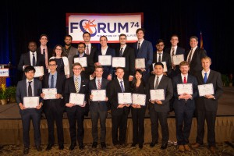
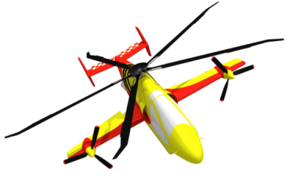
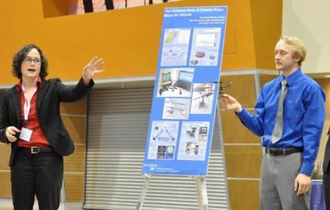
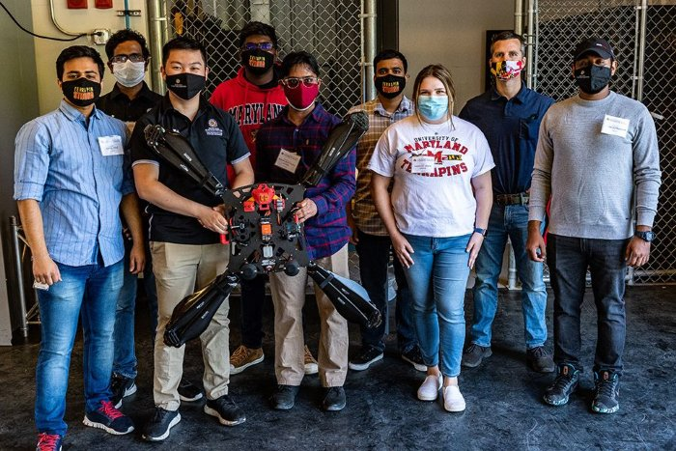
VFS Educational Outreach www.vtol.org/...
Education for the current & future workforce
  Conferences, short courses, publications, etc.
Vertical Flight Foundation (VFF)
  $100,000 of scholarships!
Student Design Competition (SDC)
  Schools from all over the world
  designing advanced rotorcraft
Pre-college (STEM) outreach
  Developing curricula and training materials
Design-Build-Vertical Flight Student Challenge
  www.vtol.org/fly
Workforce issues: www.vtol.org/workforce and www.vtol.org/DiversiFlite

Slide 10

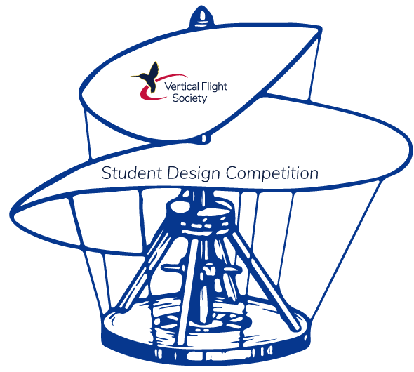
Student Design Competition www.vtol.org/sdc
2023: High Speed Vertical Takeoff and Landing (HSVTOL)
  Sponsored by Sikorsky
  $12,500 in prize money, plus travel to the Forum, etc.
2022: eVTOL Air Taxi for Passengers with Reduced Mobility (PRM)
  Sponsored by Bell Textron
Rensselaer Polytechnic Institute
1st place Graduate
University of Maryland
1st place Undergraduate

Slide 11
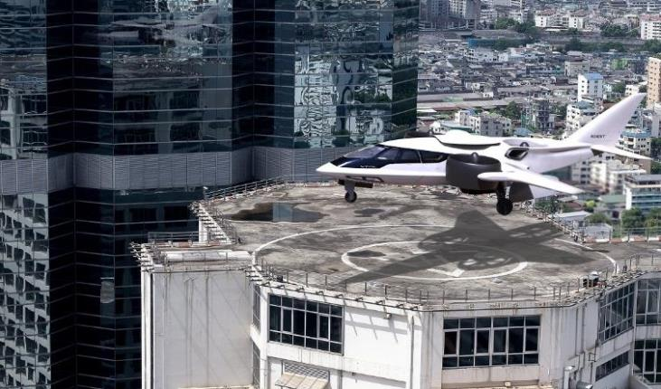


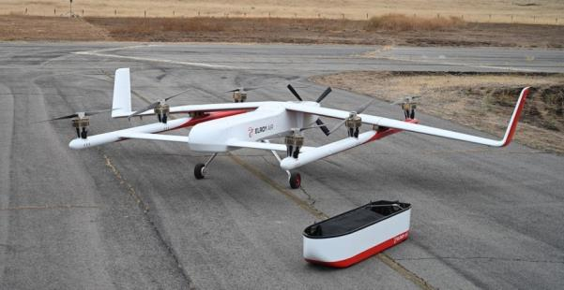
The Electric VTOL Revolution
Electric & hybrid electric propulsion enable new possibilities for:
  Regional/Rural Air Mobility (RAM)
  Urban Air Mobility (UAM)/Air Taxis
  Urban Cargo Delivery/Disaster Relief
  Personal Air Vehicles
  Ultralights
  Personal Flying Devices (GoFly)
  Urban Package Delivery (sUAS)
Heavier, Hybrid
“Advanced
Air Mobility”
(AAM)
www.eVTOL.news

Slide 12
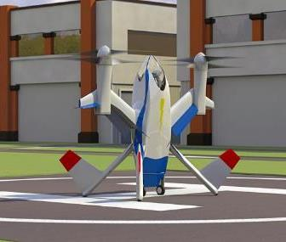
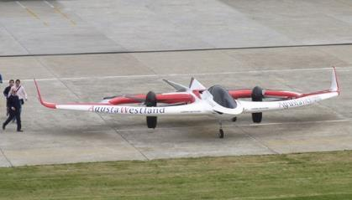
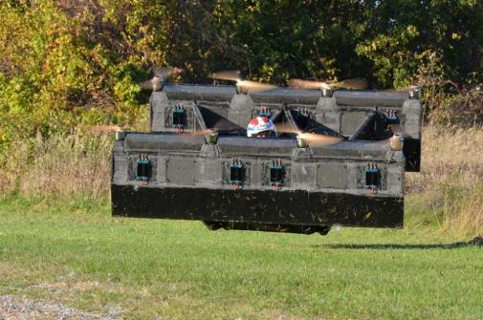
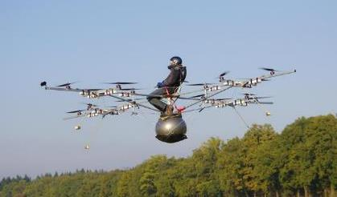
Pre-Historic eVTOL
NASA Puffin Single-Seat eVTOL
Study
(2010)
AgustaWestland Project Zero
1st Full-Scale eVTOL Demonstrator
Unmanned
(June 2011)
Solution F / Pascal Chretien
1st Manned Electric VTOL flight
(Aug. 4, 2011)
Opener BlackFly (SkyKar Rebel)
1st Manned Fixed-Wing eVTOL
(Oct. 5, 2011)
(e-volo) Volocopter VC1
1st Electric VTOL Multicopter
(Oct. 21, 2011)
www.eVTOL.news

Slide 13
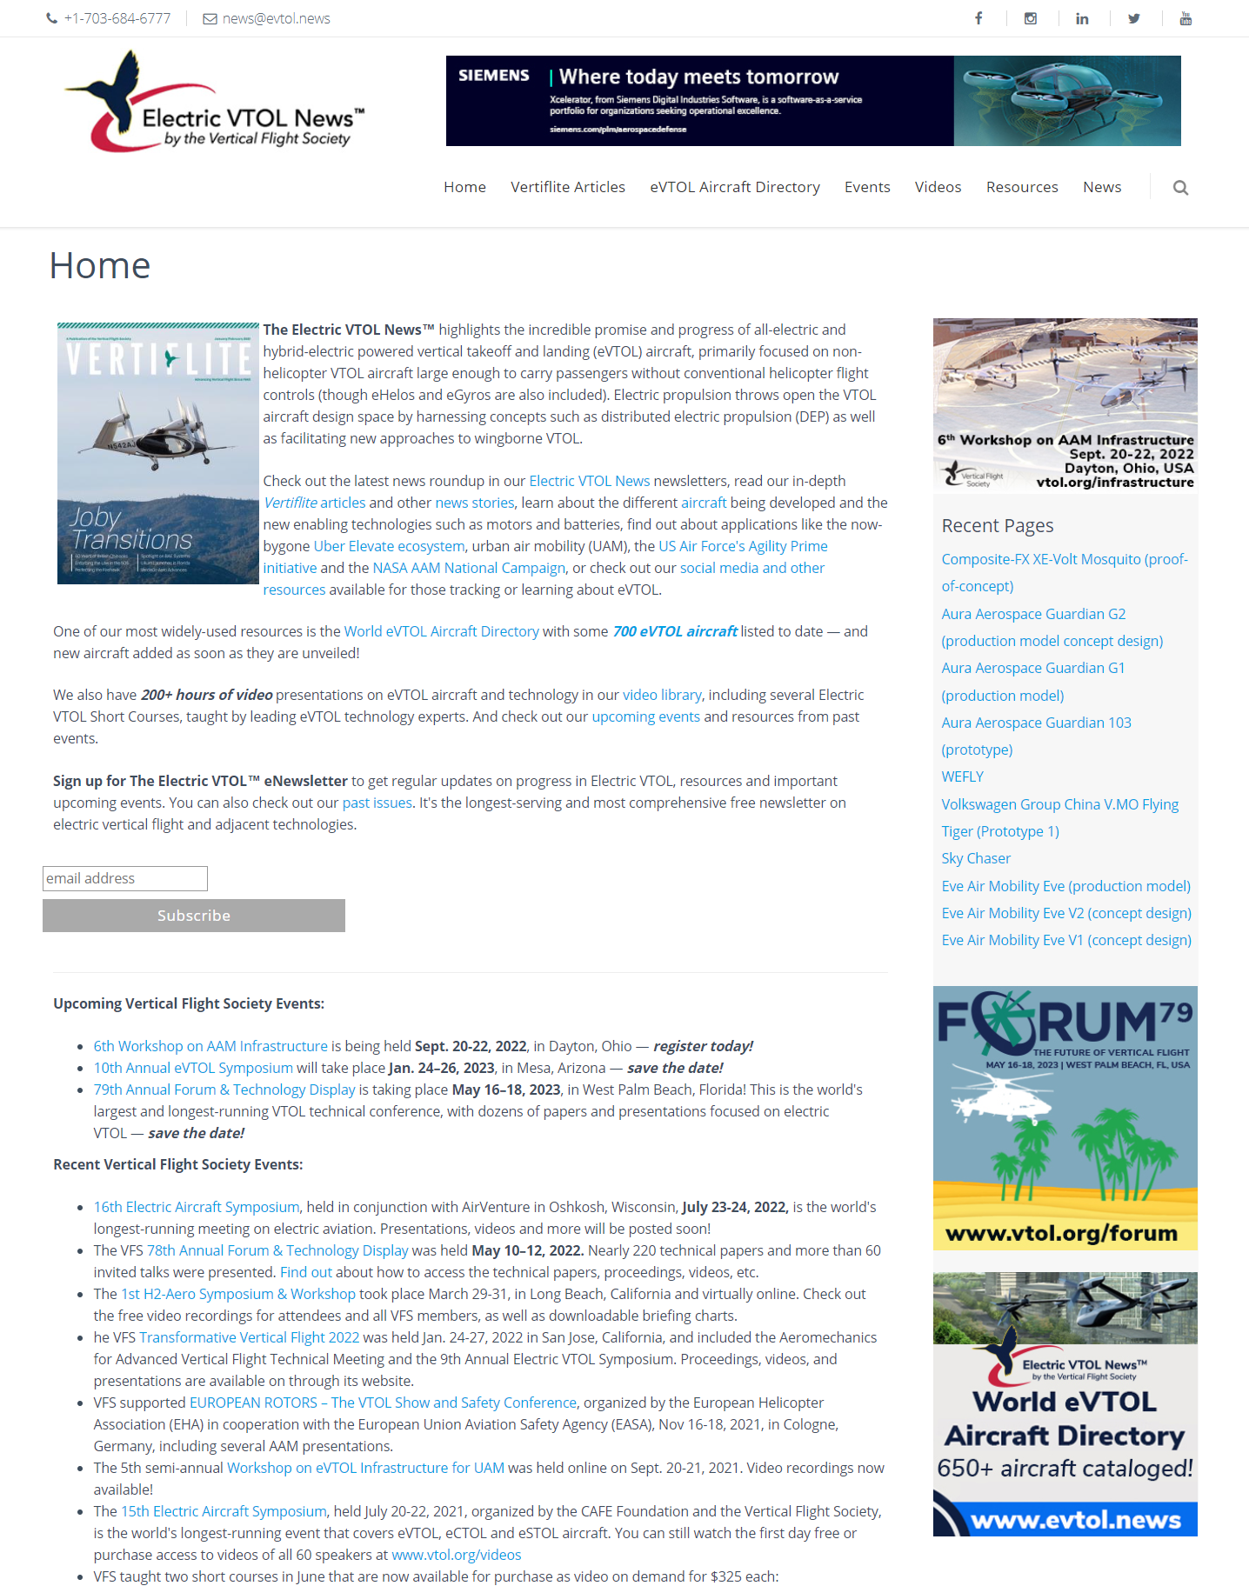
VFS eVTOL Online Resources
Electric VTOL News
  www.eVTOL.news (750+ aircraft concepts)
  www.facebook.com/electricVTOL
  www.twitter.com/electricVTOL
  www.youtube.com/VTOLsociety
  www.instagram.com/VTOLsociety
  www.vimeo.com/VTOLsociety
  www.linkedin.com/company/vtolsociety/
Also
  Electric VTOL eNewsletter
  eVTOL News videos
  eVTOL video presentations (250+ hours)
  eVTOL short course videos (100+ hours)

Slide 14
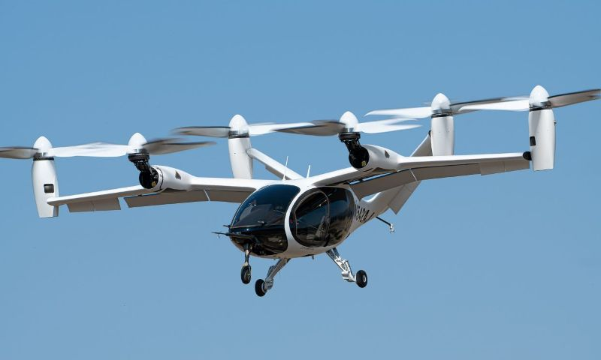
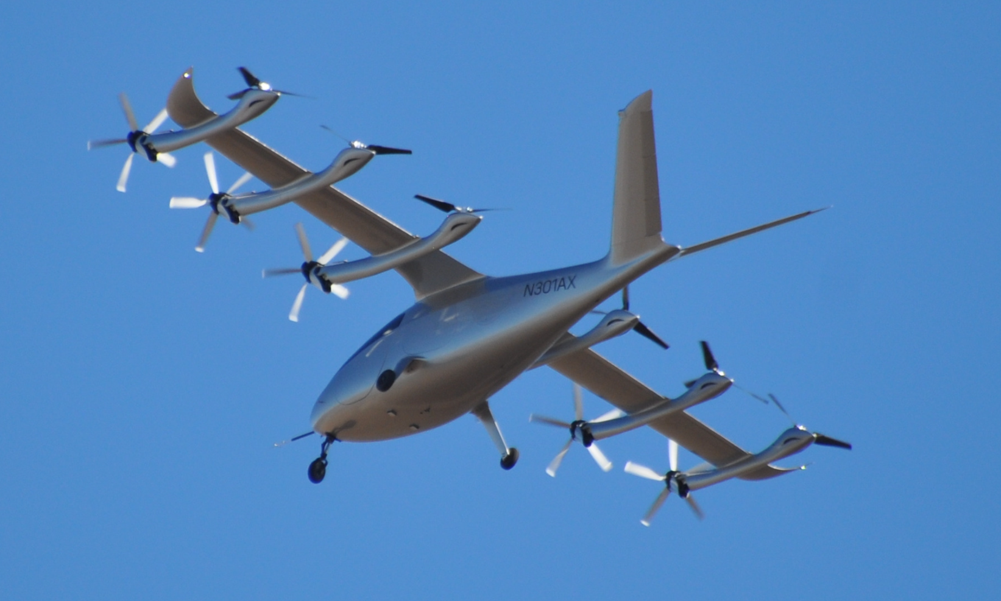
The Electric VTOL News www.eVTOL.news
World eVTOL Aircraft Directory
  Everything from the silly to the serious
876 aircraft Designs (as of Aug. 30, 2023)
  307 Vectored Thrust
  149 Lift + Cruise
  254 Wingless (multicopters)
  110 Hover Bikes/Flying Devices
  56 eHelos & eGyros
400+ eVTOL companies/designers
350+ Vertiflite articles on eVTOL
Newsletters, educational resources, etc.

Slide 15
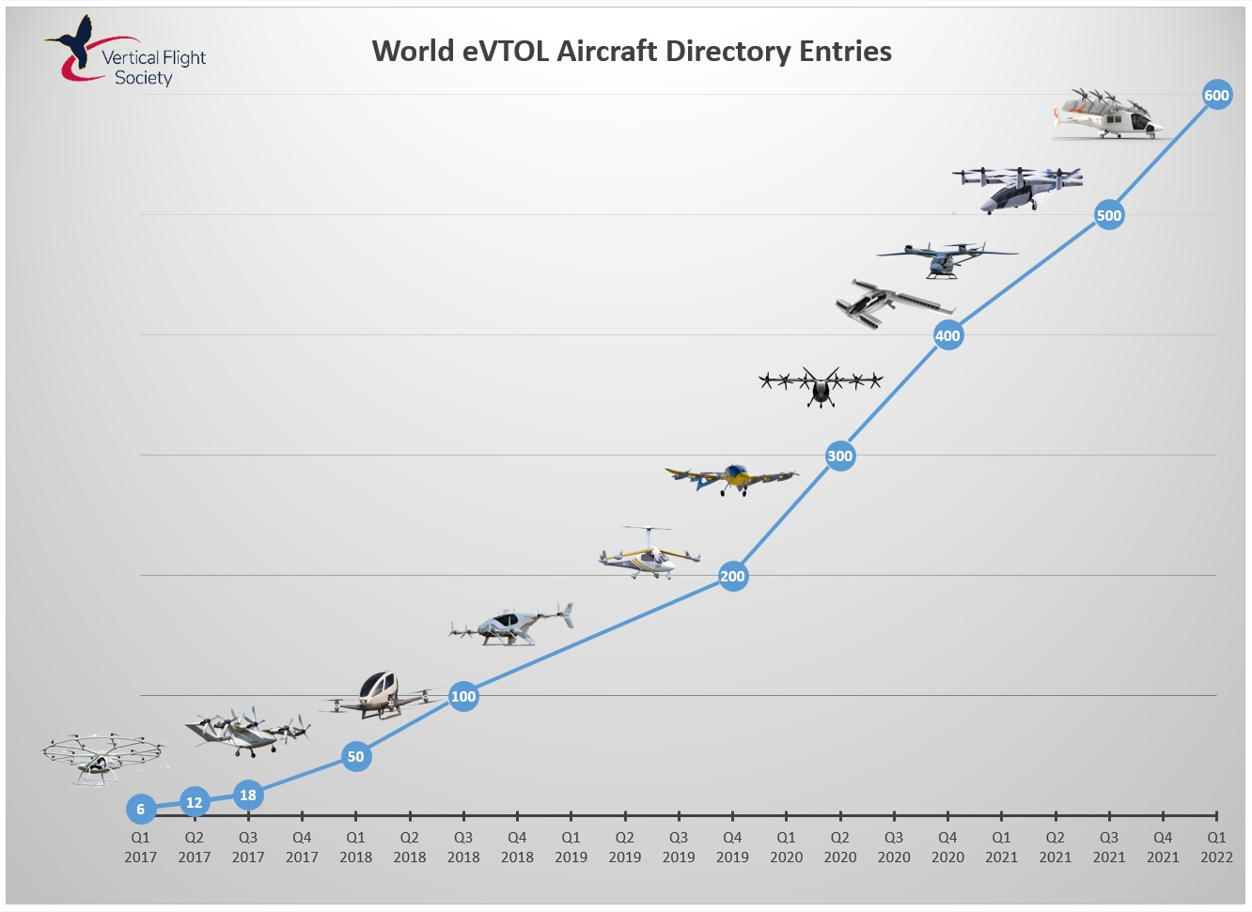

Slide 16
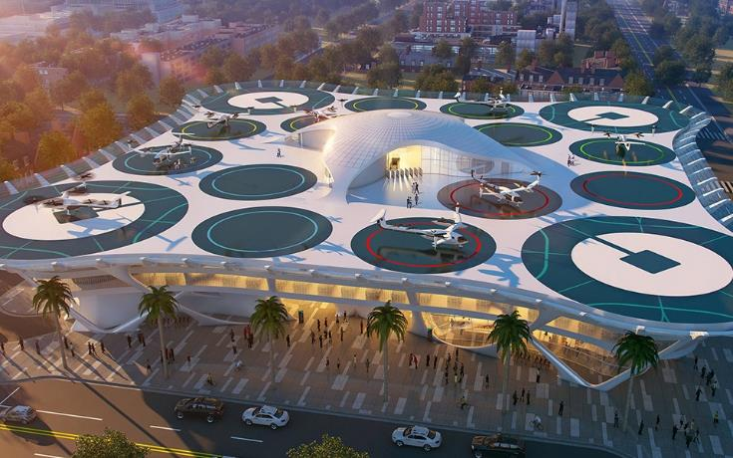
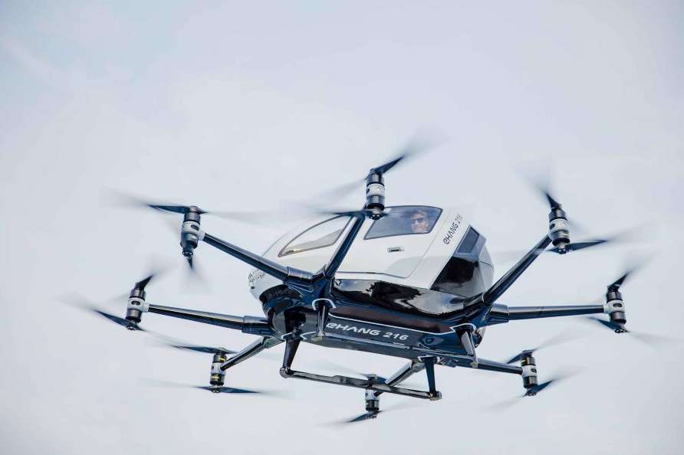
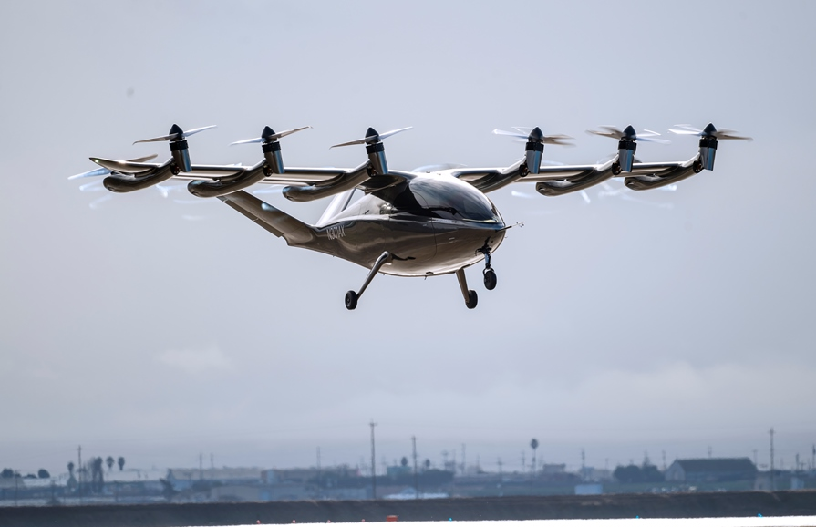
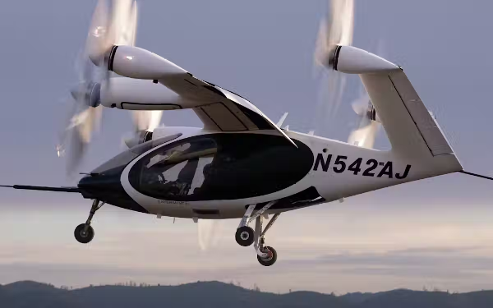
5 Key Challenges for eVTOL for UAM
Technology: batteries, motors, etc. for larger sizes, e.g. pilot + 4 pax
Infrastructure: physical and ATM/UTM
Workforce: Engineers, Pilot shortage vs. autonomy, etc.
Standards & Regulations: in development
Public acceptance: safety, noise, NIMBY
vs. rush for first-mover advantage & economic viability!
Gannett Fleming Skyport concept
EHang 2-seat EH216-S
Archer 2-seat Maker
Joby 5-seat eVTOL

Slide 17
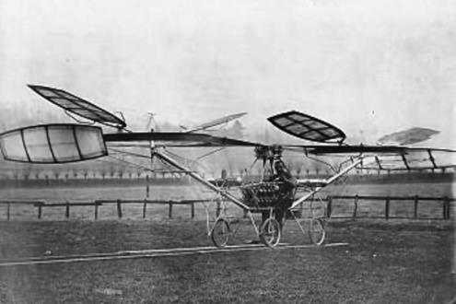
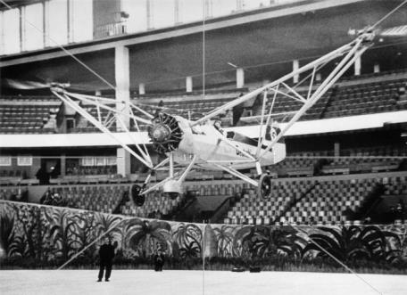
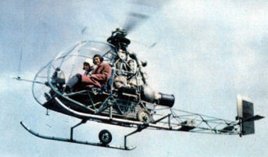
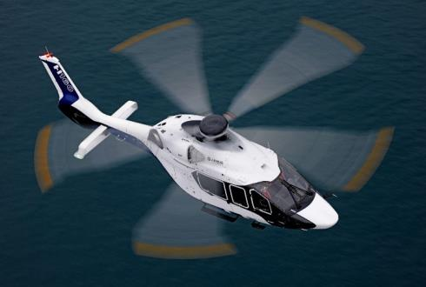
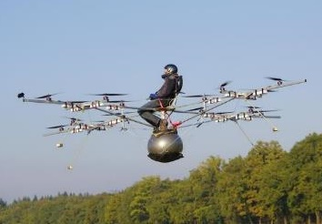
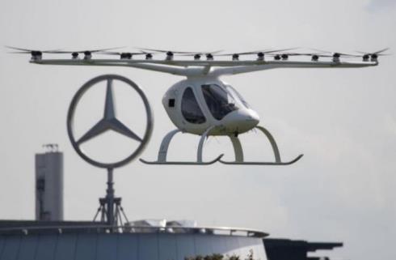
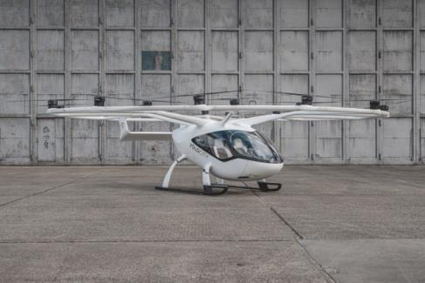
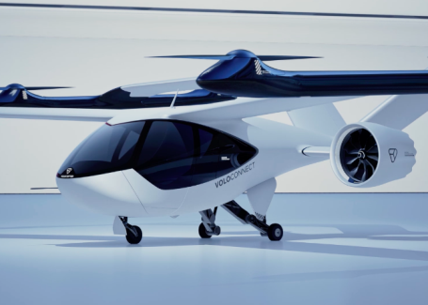
Where We Are Now
1907 Cornu (Lisieux, France)
1938 Fw 61
Deutschlandhalle (Bremen)
1953 Sud-Ouest Djinn first flight
2020 H160 (Marignane)
First hover
First public demos
Capable product
Advanced product
2011 e-Volo VC1
(Karlsruhe, Germany)
2019 Volocopter 2X
Mercedes-Benz Museum (Stuttgart)
2021 VoloCity Prototype
First flight Dec 2021
2022 VoloRegion Concept
First Flight May 2022
www.eVTOL.news

Slide 18
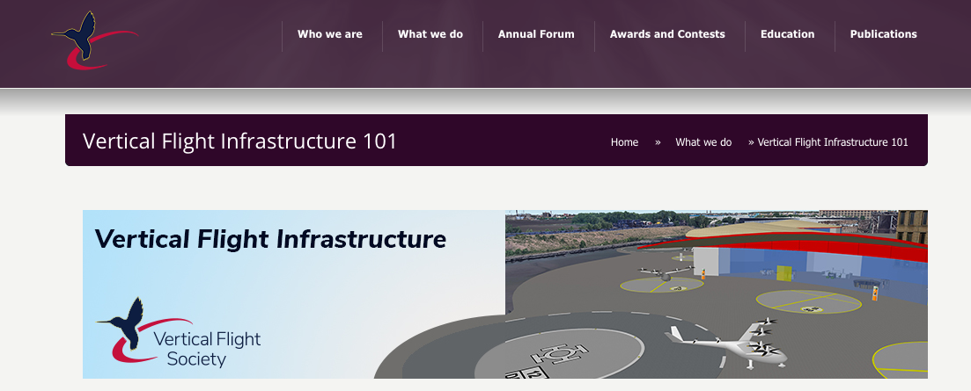

AAM Infrastructure Resources
vtol.org/infrastructure
2020 H160 (Marignane)
2022 VoloRegion Concept
First Flight May 2022
Cape May, New Jersey
And Virtual
www.eVTOL.news

Slide 19
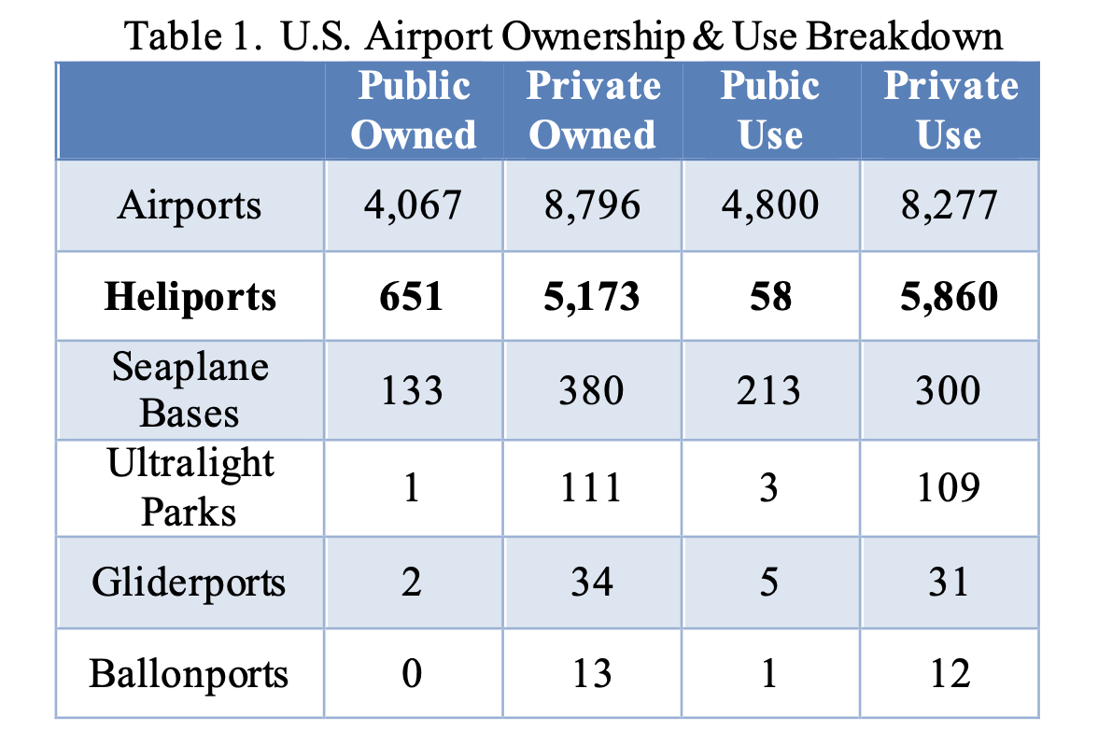
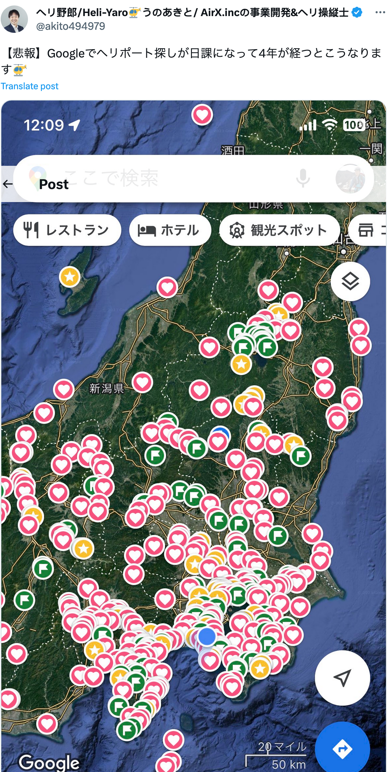
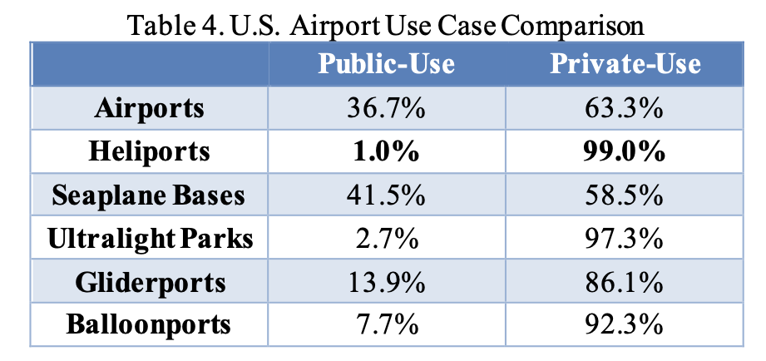
Existing Infrastructure
2020 H160 (Marignane)
2022 VoloRegion Concept
First Flight May 2022
www.eVTOL.news

Slide 20
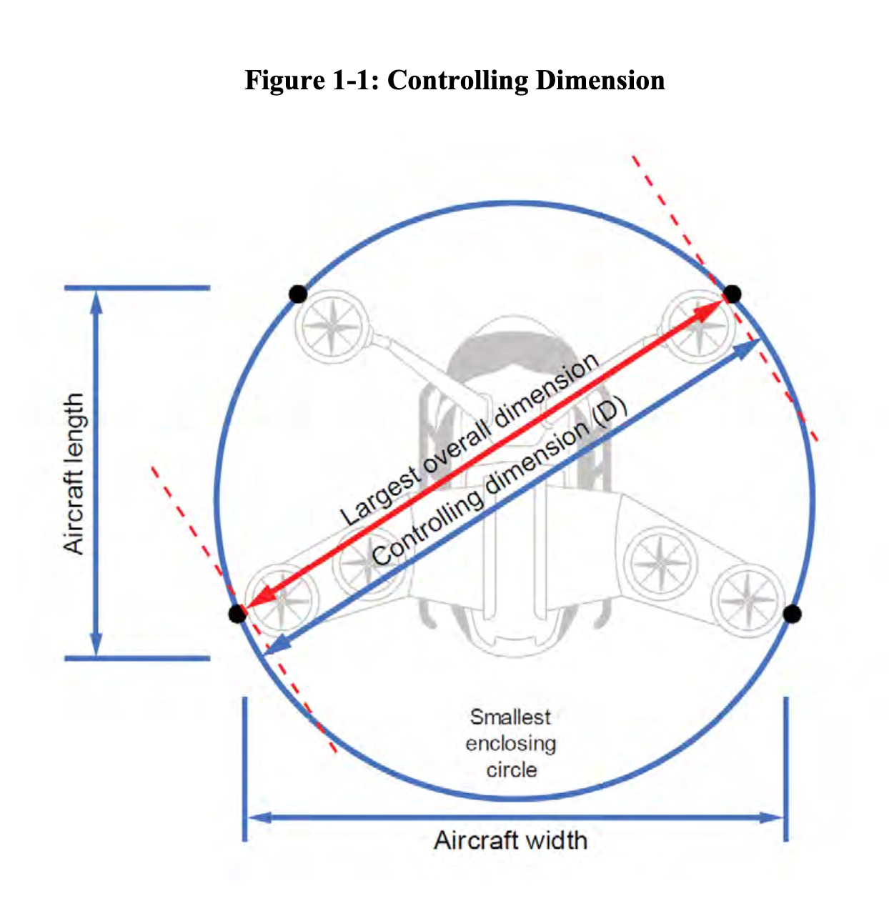
FAA Vertiport Engineering Brief
2020 H160 (Marignane)
The Vertiport EB is intended as interim guidance for vertiport design until a more comprehensive performance-based vertiport design AC can be developed.
The vertiport design criteria in this EB is intended for VTOL aircraft that meet the performance criteria and design characteristics of the Reference Aircraft described in flying in visual meteorological conditions (VMC) with the pilot on board.
2022 VoloRegion Concept
First Flight May 2022
www.eVTOL.news

Slide 21
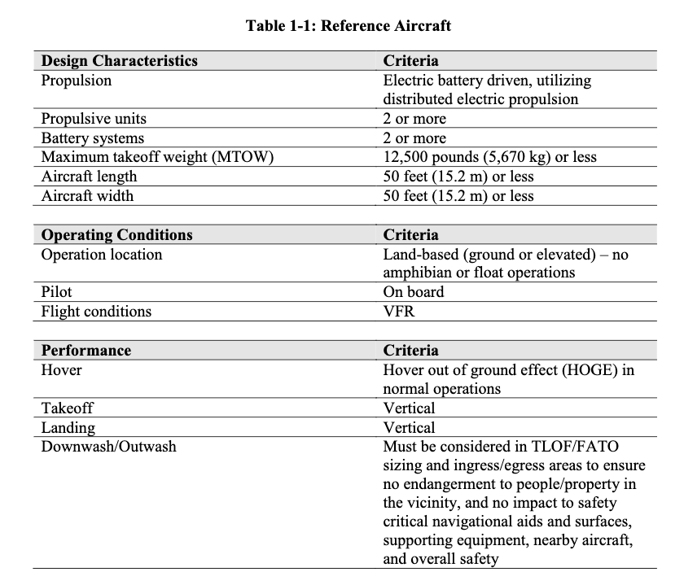
EB Reference Aircraft
2020 H160 (Marignane)
2022 VoloRegion Concept
First Flight May 2022
www.eVTOL.news

Slide 22
Future Guidance
2020 H160 (Marignane)
Will Address:
  Autonomy
  Different propulsion methods
  Density, frequency, and complexity of operations facilities
  VTOL aircraft using alternative fuel sources such as hydrogen and hybrid.
  Include aircraft that do not currently conform to the Reference Aircraft included in this EB (for example, aircraft with an MTOW over 12,500 pounds (5,670 kg))
  Instrument flight rules (IFR) capability
  The use of multiple final approach and takeoff areas (FATOs).
2022 VoloRegion Concept
First Flight May 2022
www.eVTOL.news

Slide 23


Other Standards
2020 H160 (Marignane)
F3423, Standard Specification for Vertiport Design
  (Published Aug 2022)
418, Standard for Heliports & Vertiports
  (Expected Dec 2023 / Jun 2024)
2022 VoloRegion Concept
First Flight May 2022
www.eVTOL.news

Slide 24


Community Acceptance
2020 H160 (Marignane)
2022 VoloRegion Concept
First Flight May 2022
www.eVTOL.news

Slide 25
Summary
VFS is the global Vertical Flight Society
  We are helping to shape the future of vertical flight!
  $Billions going into new military & civil high-speed/long range rotorcraft
  Find out more at www.vtol.org and join us!
Significant funds being invested in electric VTOL (>$10B)
  875+ concepts — significant work in hybrid/electric VTOL aircraft
  The explosive interest in drones is being repeated with manned eVTOL
  The Electric VTOL Revolution is transformative like the turbine engine
  VFS has been leading electric flight transformation since 2014
  Find out more at www.eVTOL.news

